Slide 1
Design and Implement a Simple RNN Sutram Solutions | NLP Task - Classification & Text Generation

Slide 2
Objective
This assignment aims to evaluate your understanding and implementation skills related to:
- Recurrent Neural Networks (RNNs) for Natural Language Processing (NLP)
- Using the Keras library (TensorFlow backend preferred)

Slide 3

Tasks: 1. Text Classification (Math, Science, History) 2. Next Word Generation (20-word prediction)

Slide 4

Evaluation Criteria
- Dataset Creation Quality
- Correctness of Implementation
- Understanding of RNNs
- Model Implementation
- Text Preprocessing Skills
- Clarity of Code and Documentation
- Problem-Solving Approach
- Basic Evaluation/Demonstration

Slide 5
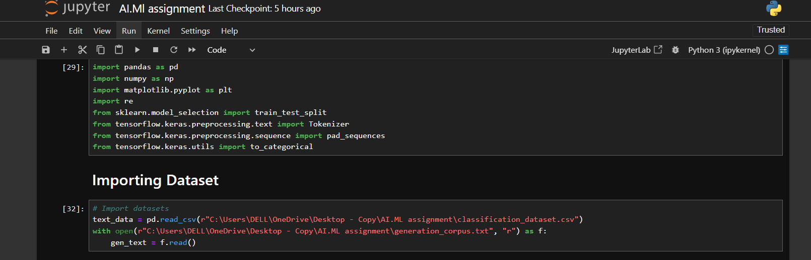
Implementation Plan
Phase 1: Dataset Creation
- Create labeled data for classification
- Create a long educational corpus for generation

Slide 6
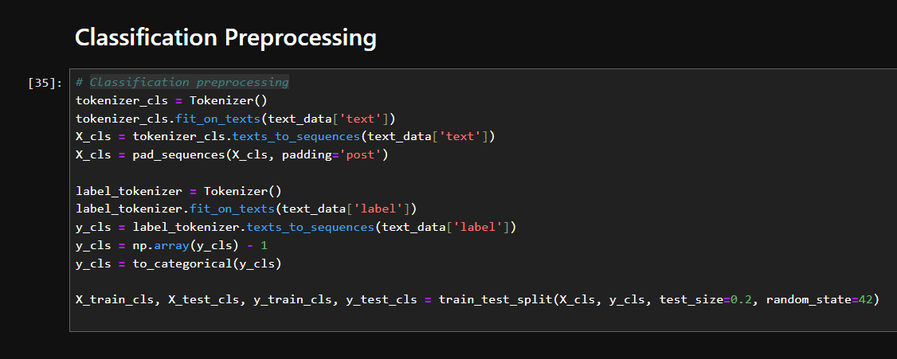
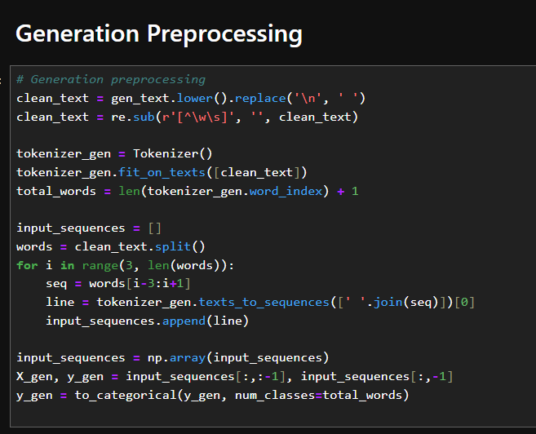
Phase 2: Text Preprocessing
- Tokenize, sequence, pad inputs
- One-hot encode targets
- Split into training/testing sets

Slide 7
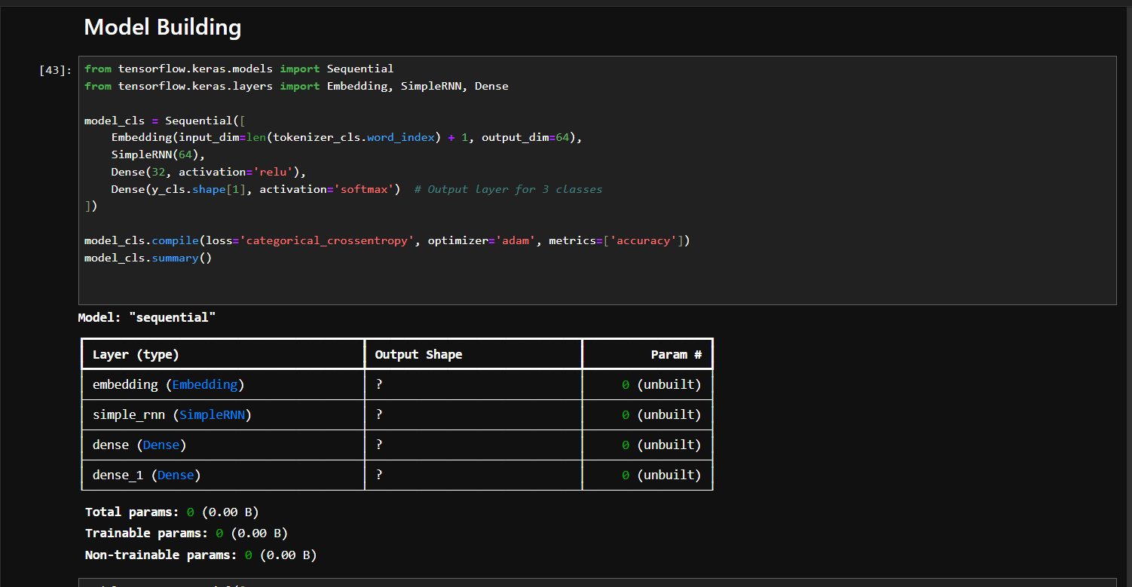
Model Building
Use SimpleRNN (or LSTM/GRU optionally)
- For Classification:
• Embedding + RNN + Dense + Softmax
- For Generation:
• Embedding + RNN + Dense (vocab size)

Slide 8
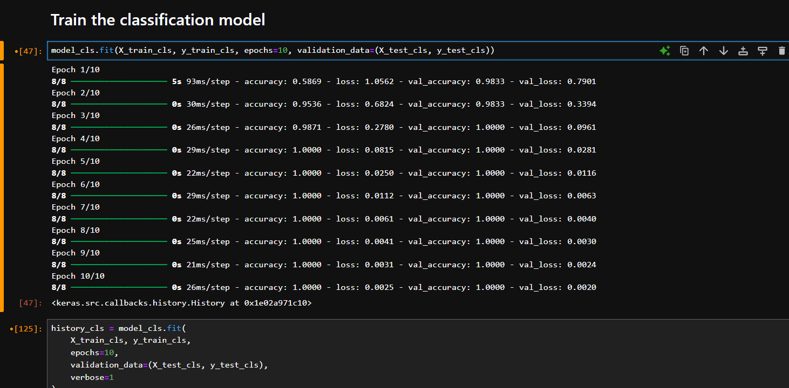
Phase 4: Training and Evaluation
Train classification model (report accuracy)
- Train generation model (predict 20 words)
- Use a sample input for demonstration

Slide 9
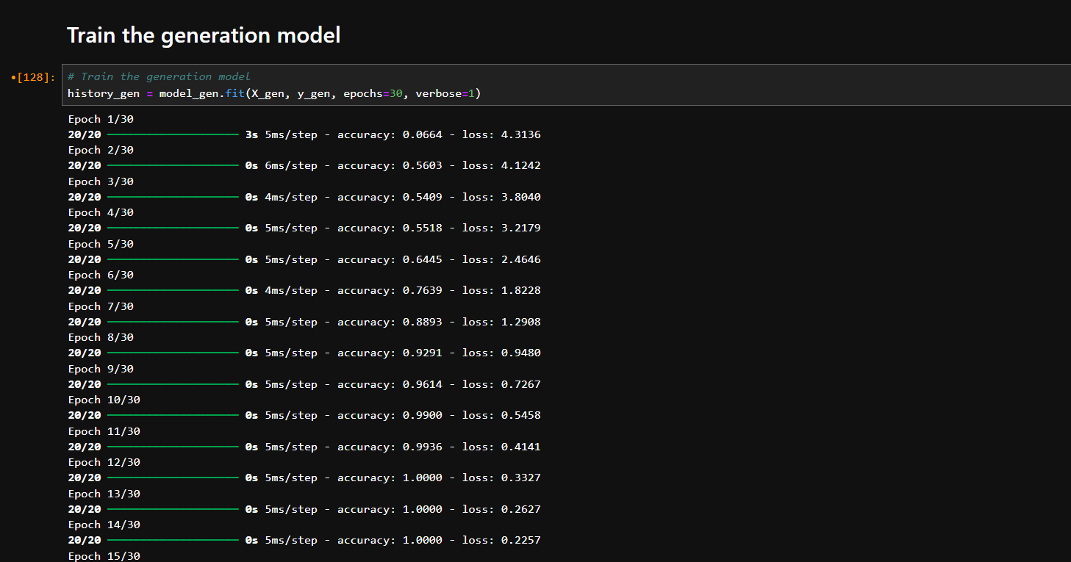


Slide 10
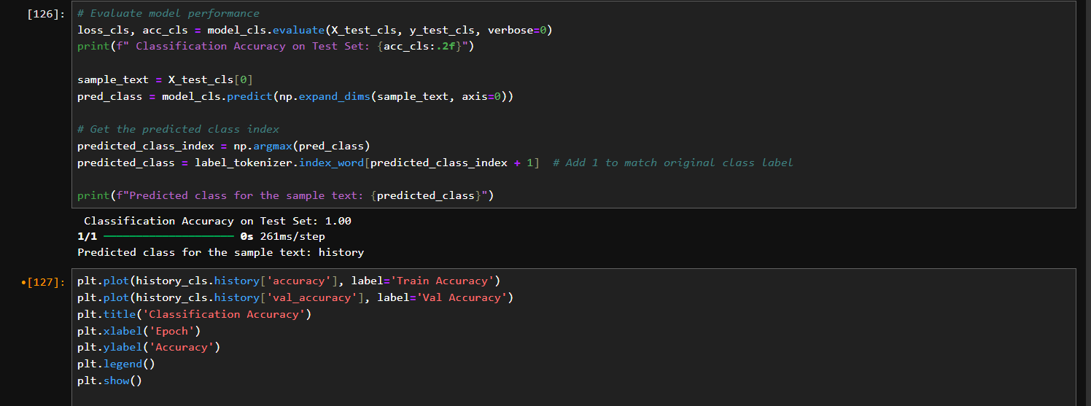
Use a sample input for demonstration

Slide 11
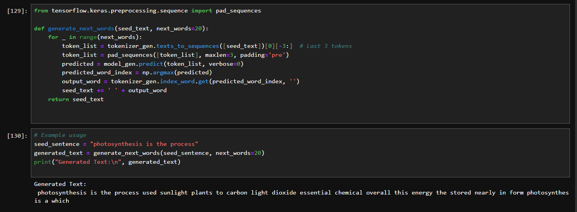
Use a sample input for demonstration

Slide 12
Documentation & Submission
- README.md with:
• How to run
• Sample input/output
Push to GitHub with naming convention
https://github.com/rutuja-pawar114/rutuja_pawar_nlptasks
- Submit link as instructed

Slide 13
Thank you
Sutram Solutions | NLP Task - Classification & Text Generation

